Slide 1

CASE STUDY
DATABASE MANAGEMENT SYSTEM
PERFUME

Slide 2
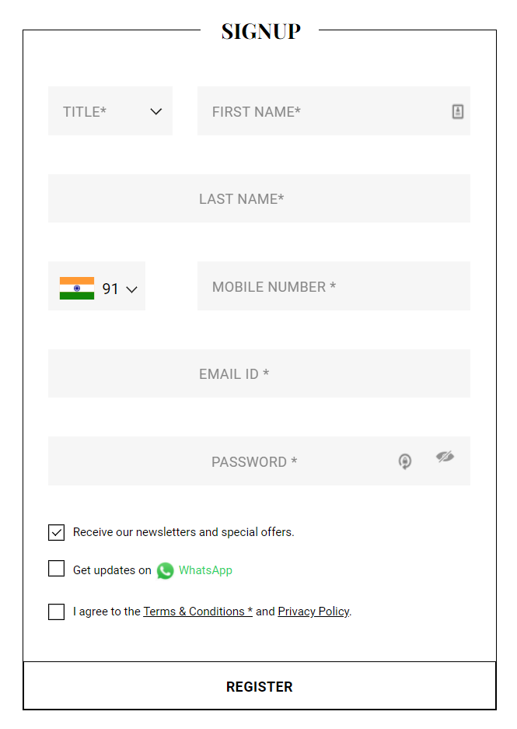
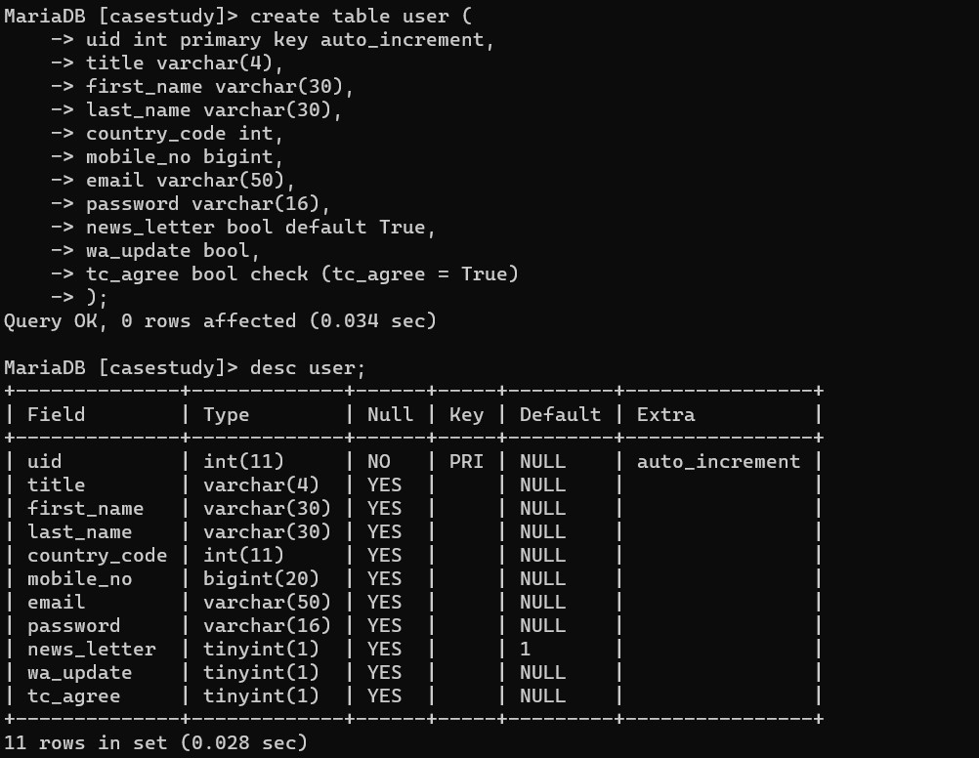
QUERY FOR CREATE USER TABLE

Slide 3
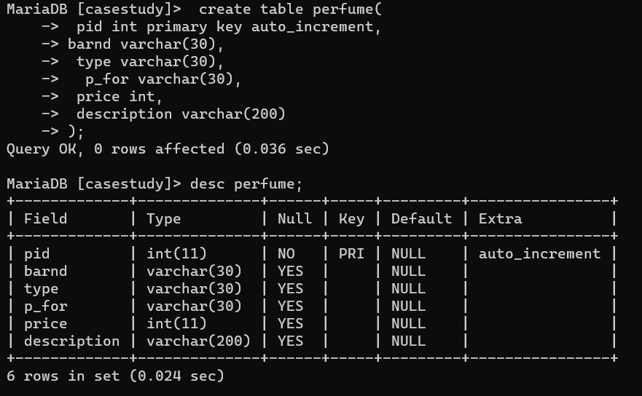
CRAETE QUERY FOR USER TABLE

Slide 4
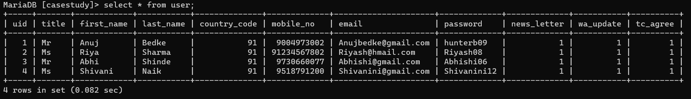
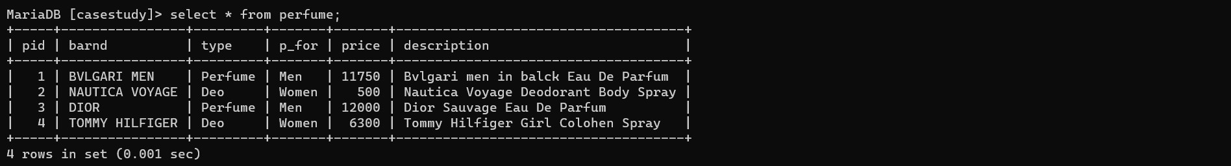
SHOW USER AND PERFUME

Slide 5
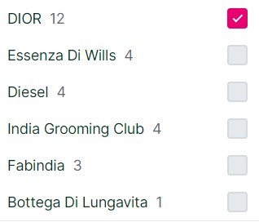
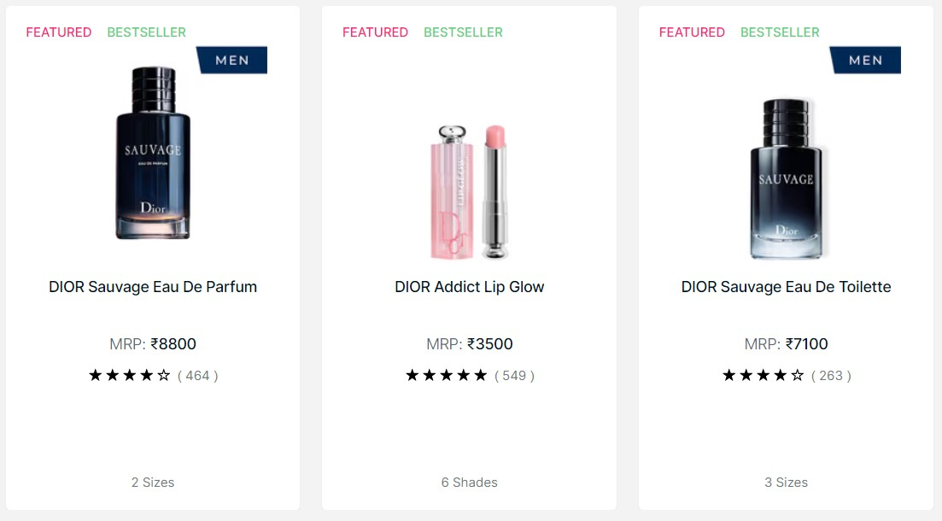
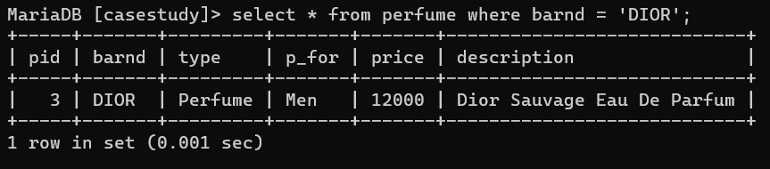
SHOW PERFUME BY BRAND :

Slide 6
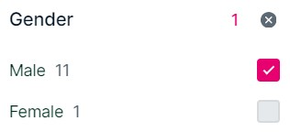
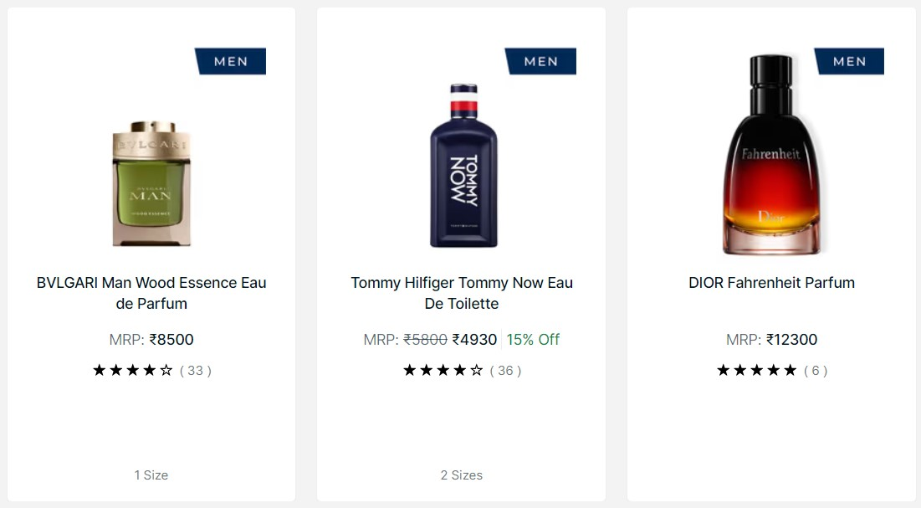
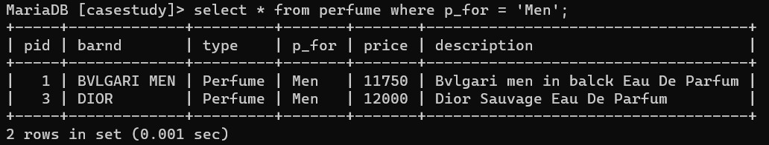
SHOW PERFUME FOR MEN

Slide 7
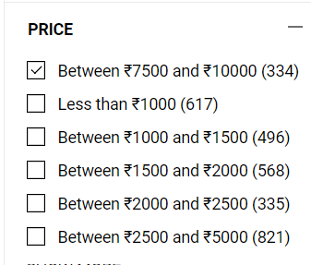
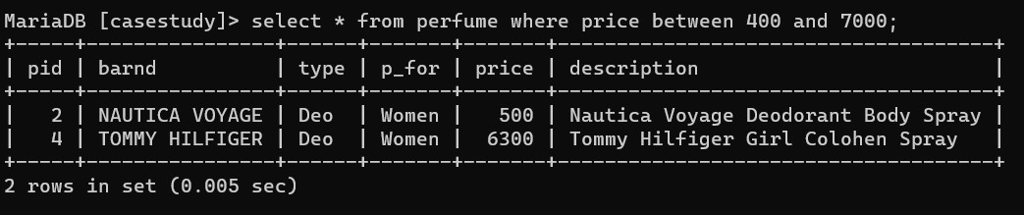
SHOW PERFUME IN PRICE RANGE

Slide 8
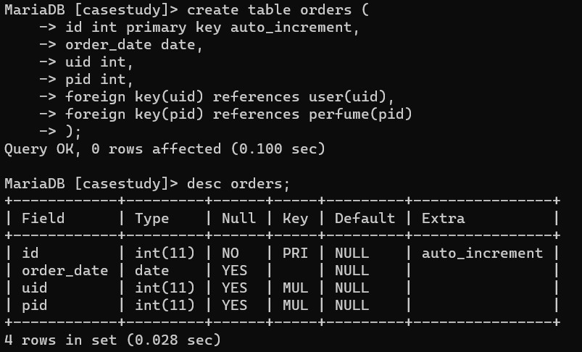
CREATE ORDERS TABLE

Slide 9
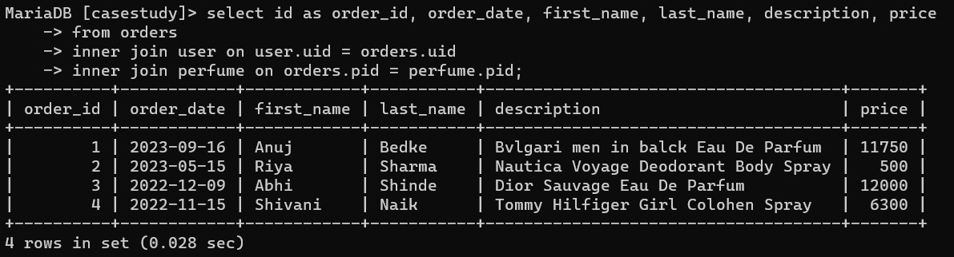
SHOW ALL ORDERS WITH CUSTOMER NAME AND PERFUME DESCRIPTION

Slide 10
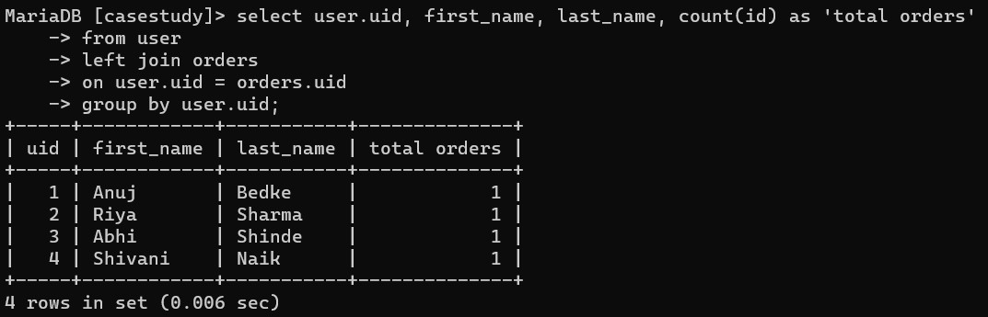
SHOW ORDER COUNT OF EVERY USER

Slide 11
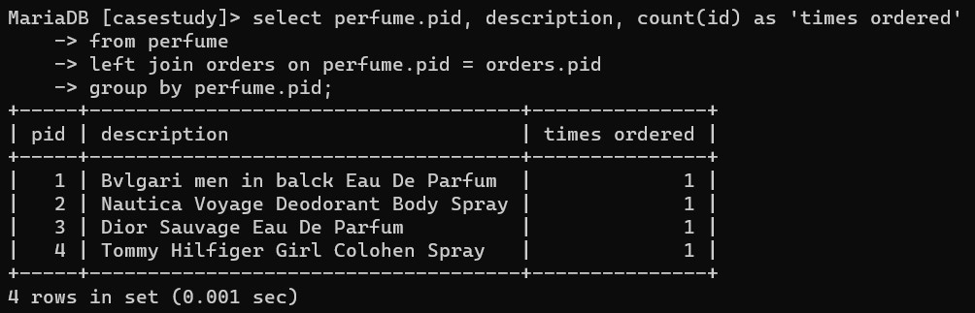
SHOW ORDER COUNT OF EVERY PERFUME

